Slide 1
Deep Learning from Research to Production using Apache MXNet*
Ankit Khedia
Amazon AI
©2018 Amazon Web Services, Inc. or its affiliates, All rights reserved
Notes:
Hi everyone!
My name is Ankit Khedia, I work as a Software Engineer with Amazon AI, working with my team to make Deep Learning Systems easily usable by developers and scientists. Most recently I have been working on Apache MXNet Gluon and ONNX Model Zoo
I this talk, Sandeep and I will be taking you through a journey, from incepting an AI model, through training the model, and all the way to deploying it as a service. We chose the problem of facial expression recognition, but it is pretty much an arbitrary choice, and we could have chosen other models.
By the end of this talk, you will know the basics of taking an idea for an AI model, and building it up all the way to production – so make sure you are listening carefully ☺
Feel free to ask questions during the talk, and if you want to chat some more - I’ll be here after the talk.

Slide 2
Brief Intro to Deep Learning
Can machines think?
Can machines do what we can? (Turing, 1950)
AI
Machine Learning
Deep Learning
Data
Data
Machine Learning
Traditional Programming
Rules
Answers
Answers
Rules
Notes:
OK, let’s get going. We'll start with a brief intro to deep learning to understand what it is and why it matters.
With a show of hands – How many of you have experience with ML? know what Deep Learning is? How many have ever implemented a neural network? How many have deployed one to production?
Let’s start with AI. AI is an active research area dating back to at least the 50s if not earlier. Investigating the various aspects of enabling machines to mimic, and surpass, human intelligence. Alan Turing, a computing pioneer, calibrated the essence of AI by moving from the philosophical question “can machines think” to a more relevant question “can machines do what us humans can?”
ML is a subset of AI, and is really a different programming paradigm. Traditional programming, that is mostly taught at schools, is about us humans programming rules, and the machine executing these rules on data to provide answers. ML is taking in data and answers, and constructs the rules by itself. This is closer to how humans learn from experience.
So ML is the set of techniques that enables machines to learn rules from data, without being explicitly programmed. ML is really an umbrella term that includes algorithms like decision trees, SVM and also neural networks.
This takes us to Deep Learning. DL is a subset of ML, a technique inspired by the human brain – or neurons to be more exact – that uses interconnected artificial neurons to learn from samples.

Slide 3
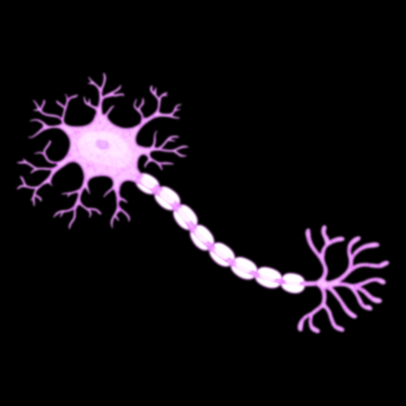

Brief Intro to Deep Learning – Artificial Neurons
Inspired by the brain’s Neurons
We have ~100B of them, and ~1Q Synapses
Inputs
Weights
Non-Linear Activation
x₁
w₁
$$y= φ(\sum_{j=1}^{n}{wjxj)}$$
Σ
φ
𝑦
x₂
w₂
…
x_{n}
w_{n}
Notes:
So at the base of Deep Learning there is the artificial neural network, and at the base of that there is the artificial neurons.
Artificial neurons are inspired by the human brain’s neuron cells. These cells are abundant in the brain, we have ~100B of them, they receive, process and transmit information through electrical and chemical signals. They are connected to one another via Synapses, which we have ~1Quadrillion of (that’s 1000 trillion) – and form neural networks that are responsible for much of our brain and spinal cord activities.
Artificial neurons are only inspired by real neurons, actual design and implementation differs significantly. In fact, the AN construct is pretty simple:
We have inputs coming into the AN, and each input has a weight parameter assigned to it. There is a linear combination of the input vector and the weight vector, and the output scalar is fed into a non linear function that then spits out another scalar. The non-linear function is very important, since it makes the overall network able to handle non-linear features.
That’s it. This output is, in turn, becoming one of the input of another neuron.

Slide 4
Brief Intro to Deep Learning – Neural Networks
Non linear
Hierarchical feature learning
Scalable architecture
Computationally intensive
Many More…
Input Layer
Hidden Layers
Output Layer
Notes:
Now, a Neural Network at its most simplistic form is composed of layers, each consisting of a set of artificial neurons, that are interconnected across layers with weighted edges. The term “deep learning” was coined due to these networks having many hidden layers, which makes them “deep”. The network takes the input vector, matrix, or more generally tensor, and feeds every element of the input into a unit in the input layer. From there the computation cascades across the units and layers, until we get an output in the output layer. Neural networks are non linear functions, and can learn non linear features, as the activation functions in each neuron is non linear. They enable learning features in a hierarchical way, with each layer learning a feature that is leveraging the features learned in the previous layer. And very importantly: it is a scalable architecture that can be made more complex with more learning capabilities by enlarging the network and/or modifying the operators in neurons. And it is typically very heavy computationally. Modern networks such as resnet-152 have hundreds of layers and requires billions of FLOPs to compute just a single prediction.

Slide 5
Training Neural Networks
Forward Pass
Input Data
Neural Network
Inference
Backwards Pass
Update Weights
Back Propagate
Loss
Backwards Pass is where the magic of learning happens, leveraging Gradient Descent.
Notes:
The difficult part is training the network, so we can find the right weights that will approximate the function modeling the problem we are trying to solve.
We start with the “Forward Pass”, in which we take a sample from our labeled input data, feed it through the network to get the inference, or prediction result.
We then do the “Backwards Pass”, also called “Backprop”, where we calculate the loss, i.e. how bad did the network did compared to the “Ground Truth” – the label of the sample input data – and then we back propagate the loss across the network, finding the gradients of each weight to identify the direction of the error.
We then update the weights across the network, in a direction opposite to the gradient, and in a value that is typically a fraction of the gradient – this fraction is called the “Learning Rate”.
The Backwards Pass is where learning happens. Through repeated iterations, we are leveraging the gradient to take down the loss, until we converge into a low error rate.

Slide 6
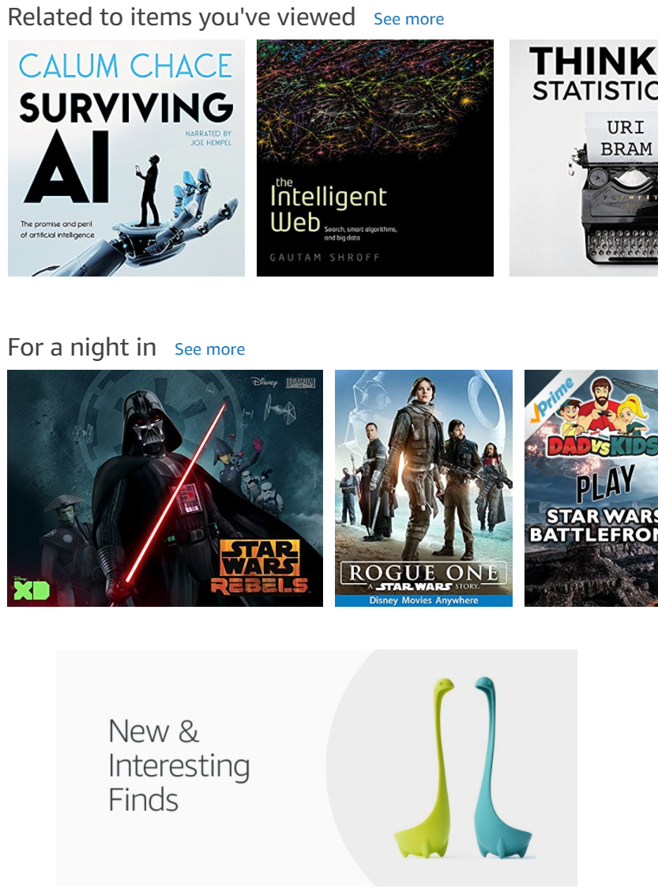
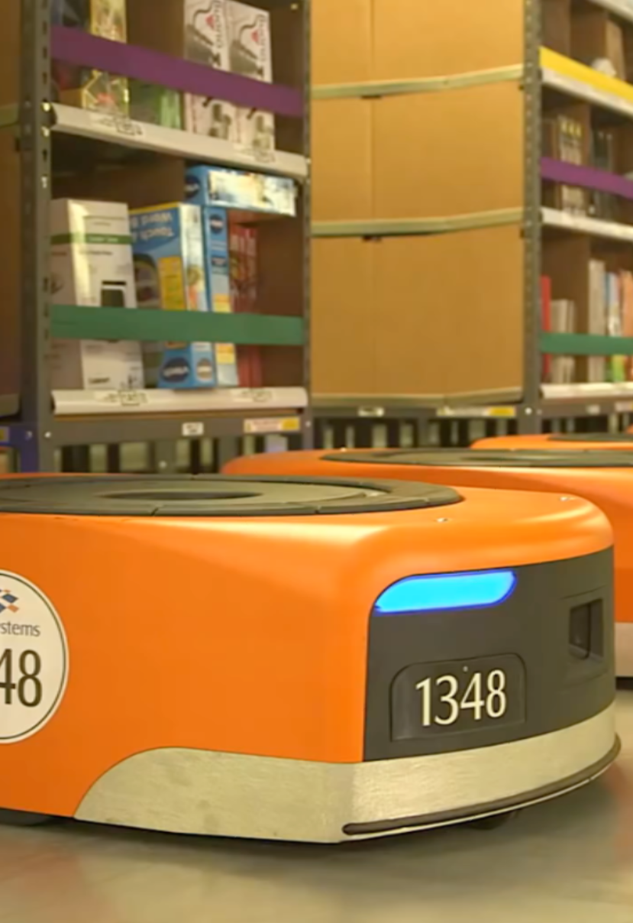
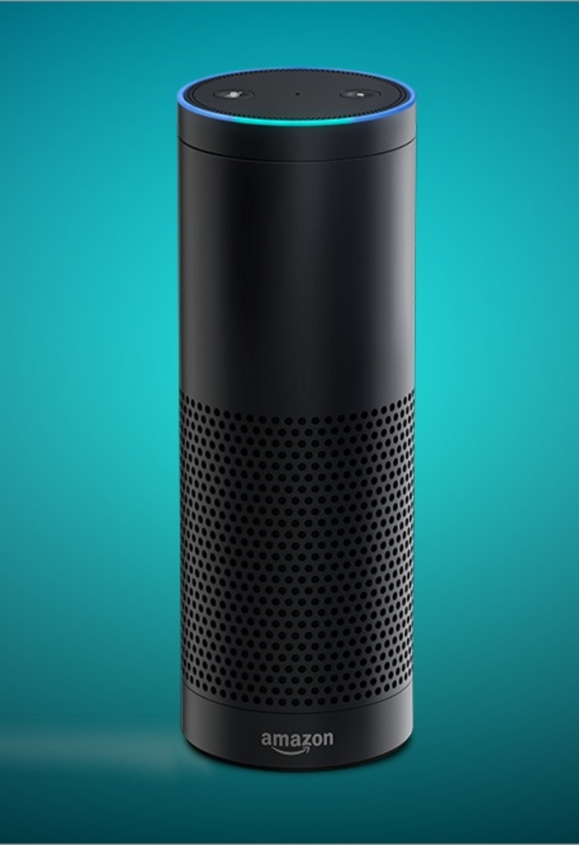
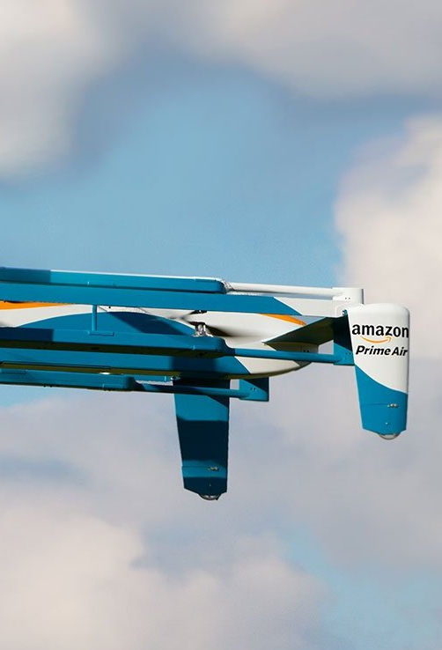
Deep Learning is a Big Deal
It has a growing impact on our lives
Autonomous Vehicles
Personalization
Logistics
Voice
Notes:
A bit about why Deep Learning is a big deal
You can see Deep Learning applied in more and more domains, with a growing impact on our lives.
If you look at the breadth of AI applied within Amazon alone, you can see DL in the Retail Website within personalization and recs, you can see it optimizing Amazon’s logistics, you probably noticed the boom voice-enabled personal assistants, and you may have heard that Amazon drones also rely on deep learning, just as other autonomous vehicles tech is relying on it. And of course the list goes on.

Slide 7
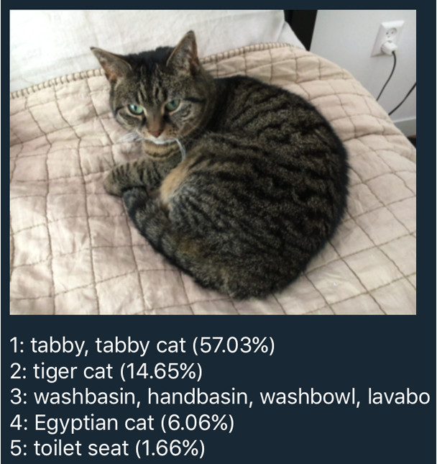
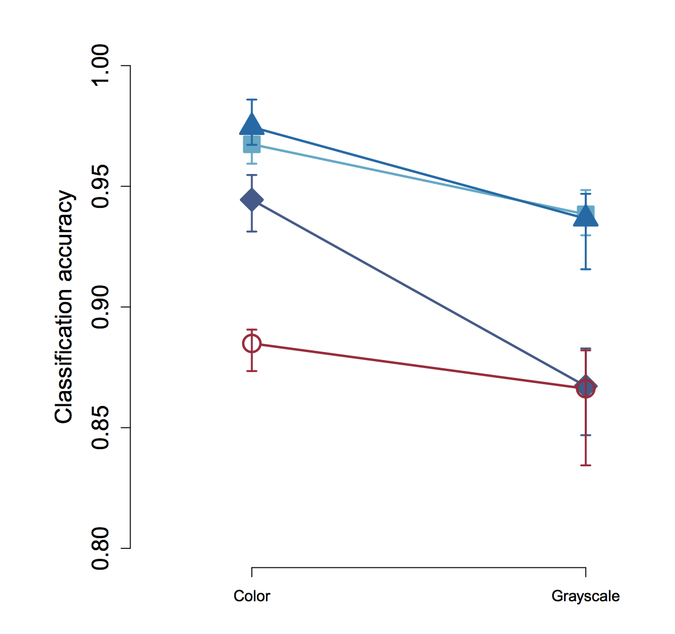
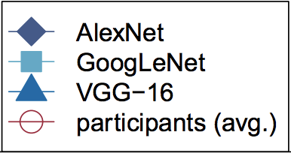
Deep Learning is a Big Deal
It’s able to do better than humans (and ML)
Notes:
Beyond the growing usage of DL in applications and devices around us, there is another interesting aspect to deep learning, and that is how well it does compared to the dominant species on this planet: us!
One of the first areas Deep Learning was able to demonstrate state of the art results, was in the domain of Computer Vision. A classical problem in that domain is Object Classification: given an image, identify the most prominent object in that image out of a set of pre-defined classes. A DNN presented in 2012 by Alex Krizhevsky, was able to leap-frog the best known algo to date by over 30%. That was really a major leap, and since then every year the best algorithm for Object Classification, and many other Vision tasks, are based on Deep Learning, with results that keep on getting better. Research paper by Geirhos from 2017 shows that DNNs already outperform humans in Object Classification – a task us humans have been programmed to specialize in by evolution. The paper also shows that human vision actually performs better when noise is introduced – it may make you feel better, it worked for me ☺
AlexNet paper: https://papers.nips.cc/paper/4824-imagenet-classification-with-deep-convolutional-neural-networks.pdf
Humans vs DNNs paper: https://arxiv.org/pdf/1706.06969.pdf

Slide 8
Facial Emotion Recognition
Notes:
OK, without further ado, let’s see how MMS looks in practice.
We’ll start with the basic use case: installing MMS, loading a model, serving it, and doing prediction.
Ready?
Demo:
Install MMS
Show the model zoo, copy a model link
Download an image
Use cURL to do inference
Examine the results

Slide 9


Misconception - AI First Strategy
Start with the problem statement!
Problem -> Is AI necessary -> Use AI
I want to use AI -> Let me solve this problem with AI -> How can I solve it now?
Notes:
2 independent steps often underestimated and combined - Identifying and formulating the problem, Solving the problem.
AI first strategy is not about starting with an assumption of applying AI in all the problems.
First step in successful problem solving, is all about identifying and formulating the problem. Then, choosing strategies and techniques that is proven to successfully solve the categories of the problem.

Slide 10
Problem Statement
XYZ bank wants to improve the customer experience rating. They recognize bank customer care representative is one of the main factor to improve the experience for customers visiting the bank branch offices. XYZ bank decides to analyze the emotion {Happy, Stressed, Tired …} of its customer facing employees in different settings {Time of the day, location, before and after event …} and strategize on –
Happy employees, happy customers!

Slide 11
Stage 1 - Problem Formulation
Scalable solution is to automate.
Capture photos of the customer care representatives and analyze the emotions.
We want a machine to be able to See, learn and classify.
A good problem to be solved with AI using Computer Vision (CV) techniques.
“We want to build a Facial Emotion Recognition model”

Slide 12
Stage 2 – Do I need to build my model?
Model Zoo
Transfer Learning / Fine Tuning
Build the Model
Is the pre-trained model available in Model Zoo - https://github.com/onnx/models, https://gluon-cv.mxnet.io/model_zoo/index.html, http://gluon-nlp.mxnet.io/scripts/index.html
Extend the pre-trained model – Transfer Learning, Fine Tuning?
SOTA
State of the Art Research (SOTA)
Build and Train the model for your problem.

Slide 13
SOTA – FER+
FER+ – Training Deep Networks for Facial Expression Recognition with Crowd-Sourced Label Distribution by Barsoum et. al. https://arxiv.org/pdf/1608.01041.pdf
8 emotion types: {neutral, happiness, surprise, sadness, anger, disgust, fear, and contempt}
Pre-trained model in ONNX model zoo - https://github.com/onnx/models/tree/master/emotion_ferplus
For this talk, let us do a transfer learning to finetune the FER+ in Apache MXNet GLUON

Slide 14

Apache MXNet - Background
Apache (incubating) open source project
Framework for building and training DNNs
Created by academia (CMU and UW)
Adopted by AWS as DNN framework of choice, Nov 2016
http://mxnet.io
Notes:
Just a bit of background on MXNet:
It is an Apache open source project. People sometimes think it is an “Amazon Project” but it is not. It is truly open source, decisions are made by the community. However, it is true that AWS is contributing a lot to the project.
It is a framework for building, training and using DNNs for inference. Similar to TF, PyTorch, etc.
It originated in the adademia, CMU and UW
Aws adopted MXNet late 2016 as “DL FW of choice), there’s a nice blog post by AWS CTO (Vogels) explaining more in details. A lot of it is about scalability and MXNet being good for production use.

Slide 15
Apache MXNet - Highlights
Ease of Use
Imperative, Symbolic and Dynamic APIs
Performance
Optimized for CPU, GPU, ARM (and more)
APIs in Python, Scala, C, C++, R (and more)
Examples and tutorials
Portability
Train on cloud, predict on edge
Highly scalable distributed training
ONNX support
Quantization, Sparse, NCCL, and more…
Model serving framework

Slide 16
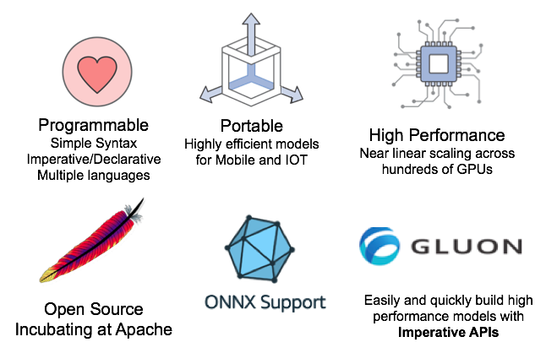

Why MXNet
Notes:
Now lets see what’s different about MXNet. Started Academia and supported by Enterprises
First, It support of multiple programming languages through Simple Syntax. It supports both Imperative and Declarative style of Programming.
Next. you can create highly optimized models for use in Mobile and IOT
It is also Highly performant, i.e., It achieves near linear scaling in training across hundreds of GPUs.
It is truly open source, currently Incubating at Apache. With a show of hands, how many of you know what it means to Incubate at Apache.
Great, for those who do not know Every project before getting accepted by the Apache Software Foundation has to go through the incubation phase where the board assigns long time Apache members as Mentors who guides and monitors the project to see that the governance is democratic and no one organization is unduly influencing.
ONNX Support – This is a new open source initiative driven by Amazon, Facebook and Microsoft to define a Interoperable format for models, this means you can train on any other DL framework and run on MXNet.
Finally, MXNet implements Gluon Imperative APIs, Gluon is an open-source effort by Amazon and Microsoft to standardize APIs for Deep Learning that are simple, ease of understand and high performant. So now you can prototype very quickly, MXNet can also generate highly-efficient Symbolic graph out of this, so you won’t loose performance.

Slide 17

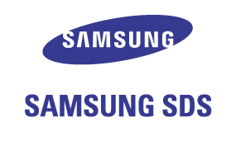
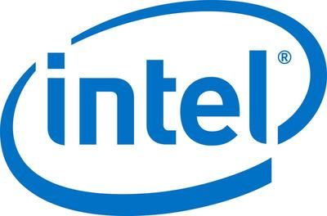


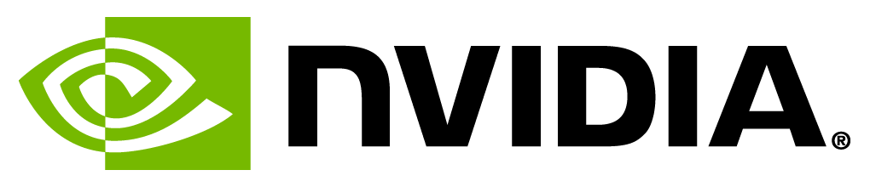















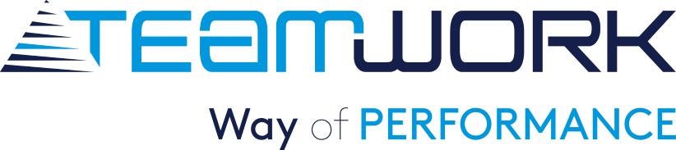





Apache MXNet Customer Momentum
Notes:
Use customer references verbally
Customers that chose MXNet due to multi-GPU training support and high scalability.
Curalate, TuSimple, Borealis AI, NTT Docomo
Designed to be easily wrapped by other languages
Wolfram integrated MXNet as the backend of Mathematica for building NN
Curalate is using Scala inference API
We have an enterprise customers who is running 100+ MXNet – Gluon models in production for product recommendation across 26M+ user base

Slide 18
MXNet Gluon – Imperative & Fast
Simple, Easy-to-Understand Code
Neural networks can be defined using simple, clear, concise code
Plug-and-play neural network building blocks – including predefined layers, optimizers, and initializers
Flexible, Imperative Structure
Eliminates rigidity of neural network model definition and brings together the model with the training algorithm
Intuitive, easy-to-debug, familiar code
Dynamic Graphs
Neural networks can change in shape or size during the training process to address advanced use cases where the size of data fed is variable
Important area of innovation in Natural Language Processing (NLP)
High Performance
There is no sacrifice with respect to training speed
When it is time to move from prototyping to production, easily cache neural networks for high performance and a reduced memory footprint
Credits: Cyrus Vahid
Notes:
Lets look into the latest Dynamic graph paradigm of MXNet

Slide 19
Transfer Learning
Training can be time consuming
Instead of training a model from scratch
Take a network trained on different domain for a different source task
Adapt it to your domain and your target task

Slide 20
Model Training Lab https://github.com/TalkAI/apache-mxnet-odsc-2018/tree/master/part1_basics_mlp_cnn/lab

Slide 21
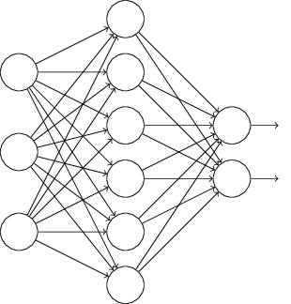
So what does a deployed model looks like?
Model
Mobile
Internet
Model Server
Desktop
IoT
Notes:
OK, so hopefully by now you are convinced that Deep Learning is awesome, and the next thing you want to do is use it in your production system.
So, how do you actually use a deep learning model in your production environment?
Let’s start with the outcome we’re trying to achieve. In fact, it is pretty straight-forward, and is not very different than deploying any other service.
We have a trained model, that we want to use for inference,
We have a bunch of clients: mobile, desktop, iot, cloud – or any combination of those
We want to have a server of sorts, hosting a trained model, exposing an inference API, which when called runs a feed forward through the network doing the deep learning “magic” Naveen explained earlier.
That’s a very simple schema of model serving setup.

Slide 22
The Undifferentiated Heavy Lifting of Model Serving
Performance
Networking
Monitoring
Model Decoupling
Cross Framework
Cross Platform
Availability
Model Server for MXNet
Notes:
As we saw in the previous slide, in many ways, serving deep learning models is similar to other, more traditional, serving frameworks out there, such as Apache Tomcat. And indeed in many ways, Model Serving is undifferentiated heavy lifting. That is a term we use and focus on in AWS a lot. What it means is all of the aspects that are necessary to get the job done, but that are not differentiating your business, things like setting up servers, networks, etc. is all UHL.
Let’s quickly go over the main concerns Model Serving system needs to address:
- Performance – this concern is about providing a scalable architecture that is able to meet target TPS, making an efficient use of the available compute resources, strike the right balance between throughput and latency. It is especially important for Deep Learning, since the computational load of running a single inference is typically significant. As a reference, a model such as ResNet-152 requires billions of FLOPs for a single forward pass.
Availability – to make your application working properly all the time, you want to minimize down time, and avoid offline status when load is high, or when you are busy deploying a new model.
Networking – making your model consumable means you need to expose a network endpoint that clients can call to get predictions. This endpoint needs to support standard interfaces such as HTTP, error codes, security and more.
Monitoring – having any service in production means you need the ability to look into your operational metrics in near-real time; things like resource utilization on host, inference latencies, requests and errors.
Model Decoupling– when you are serving models you want to offer a way that enables to use trained models without knowing anything about their inner working details. The model may be identifying cats in images, or doing sentiment analysis. No change should be done to the server beyond deploying a different model.
Cross Framework – there are many different Neural Network frameworks: MXNet, TensorFlow, PyTorch, Caffe, and more. “Same Same, But Different” - all similar, but different in style and implementation details. We want a model server that just works, regardless of the framework used to build and train the model.
Cross Platform – similar to how there are many frameworks, there are also many platforms you can run your server on. From the OS (Linux, Windows) to the actual compute processor which can be a CPU, a GPU or a TPU.
And beyond all of that, one uber-concern that is an important meta concern is Ease of Use – all of the concerns just mentioned needs to be addressed in a way that is easy to use, quick to learn, and just work!

Slide 23
MXNet Model Server
Machine learning model server
Serves MXNet and ONNX models
Automated HTTP endpoints setup
Auto-scales to all available CPUs and GPUs
Pre-built and configured containers
CLI to package model artifacts for serving
Open source project under AWS Labs
http://modelserver.io
Notes:
Just a bit of background on MXNet:
It is an Apache open source project. People sometimes think it is an “Amazon Project” but it is not. It is truly open source, decisions are made by the community. However, it is true that AWS is contributing a lot to the project.
It is a framework for building, training and using DNNs for inference. Similar to TF, PyTorch, etc.
It originated in the adademia, CMU and UW
Aws adopted MXNet late 2016 as “DL FW of choice), there’s a nice blog post by AWS CTO (Vogels) explaining more in details. A lot of it is about scalability and MXNet being good for production use.

Slide 24
Model Archive
Trained Network
Model Signature
Model Archive
Model Export CLI
Custom Code
Auxiliary Assets
Back

Slide 25
Serving Our Model
Notes:
OK, without further ado, let’s see how MMS looks in practice.
We’ll start with the basic use case: installing MMS, loading a model, serving it, and doing prediction.
Ready?
Demo:
Install MMS
Show the model zoo, copy a model link
Download an image
Use cURL to do inference
Examine the results

Slide 26
Containerization
Production-ready orchestration tools: ECS, Docker, Kubernetes
Easy to scale out
Robust and scalable images
Automatically leverages all GPUs and CPUs on host
Pre-configured images on DockerHub: awsdeeplearningteam/mms_cpu
Back

Slide 27
Containerization
Container Cluster
MMS Container
MMS Container
MMS Container
MXNet Model Server
Load Balancer
MXNet
NGINX
Pull or Build
Run
MMS Docker Image

Slide 28
Deploying Models with Containers
Notes:
OK, without further ado, let’s see how MMS looks in practice.
We’ll start with the basic use case: installing MMS, loading a model, serving it, and doing prediction.
Ready?
Demo:
Install MMS
Show the model zoo, copy a model link
Download an image
Use cURL to do inference
Examine the results

Slide 29
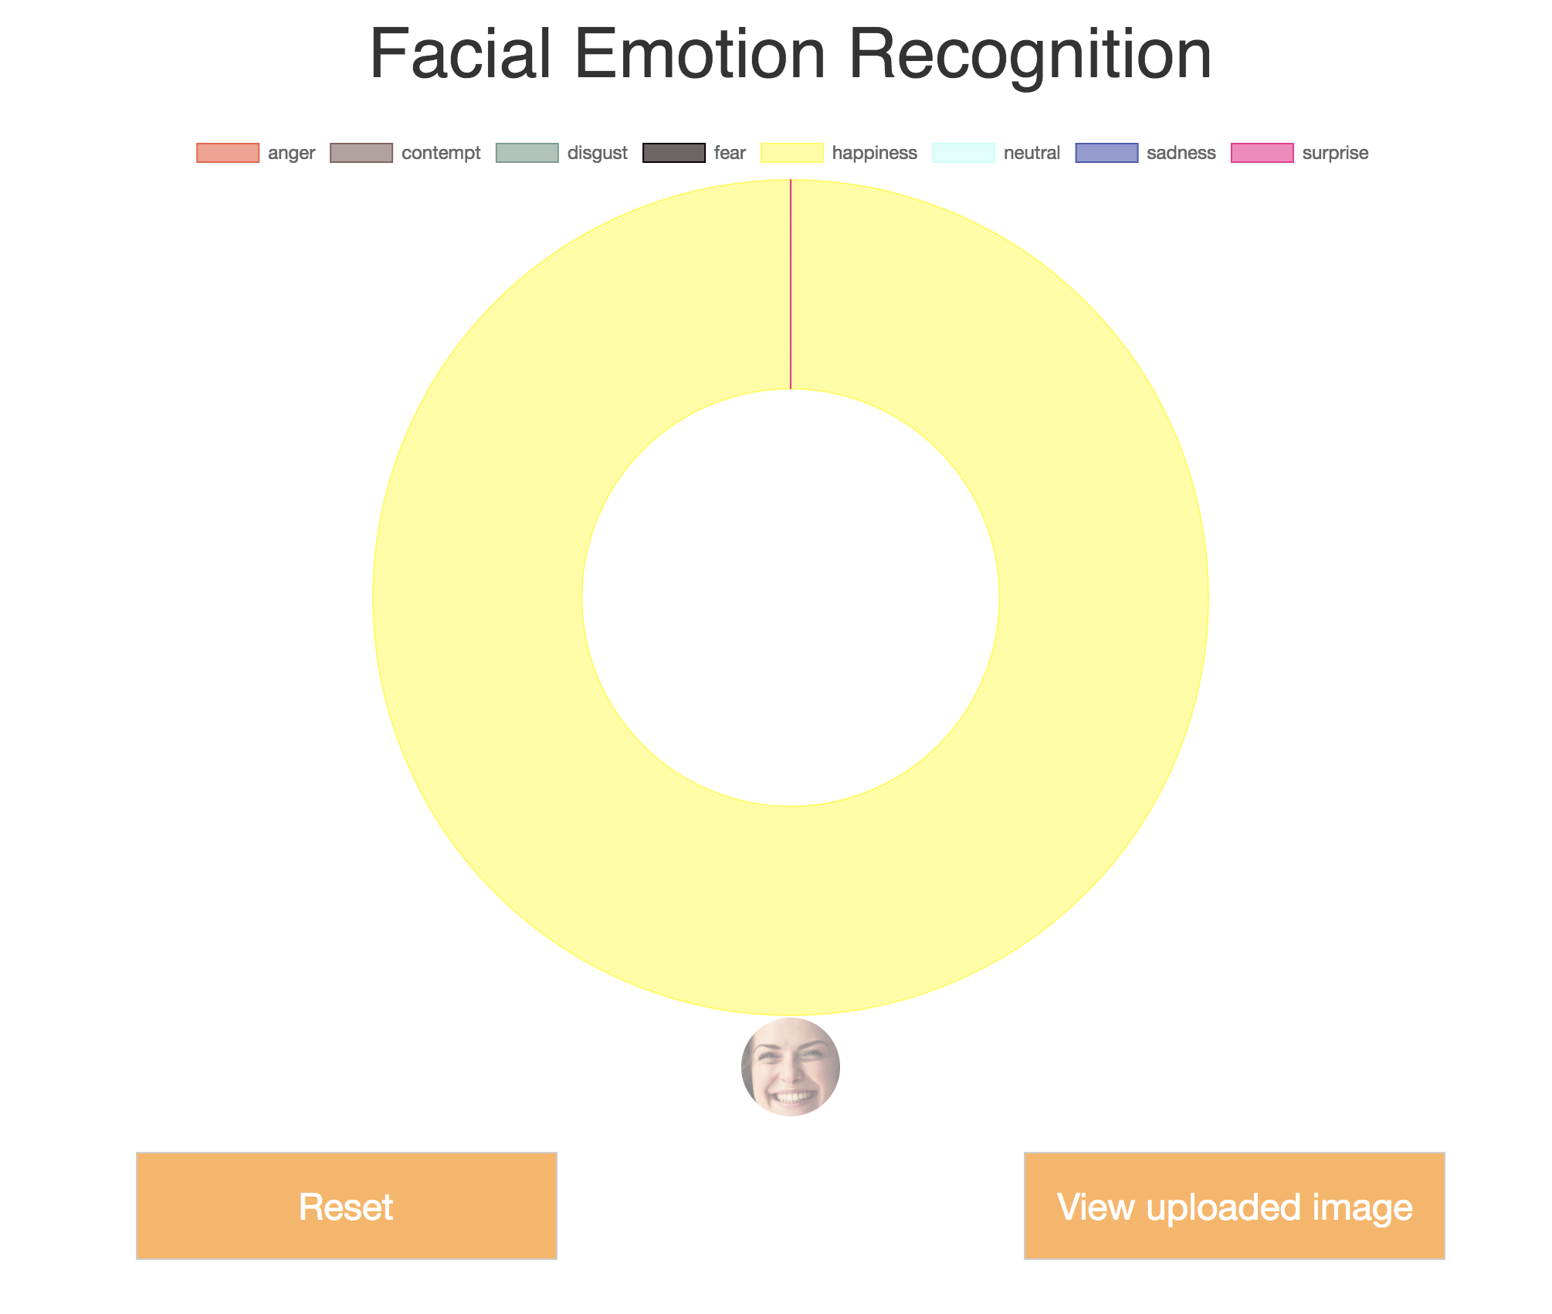
Demo - http://bit.ly/mxnet-fer

Slide 30
GluonCV: a Deep Learning Toolkit for Computer Vision https://gluon-cv.mxnet.io
50+ Pre-trained models, with training scripts, datasets, tutorials

Slide 31
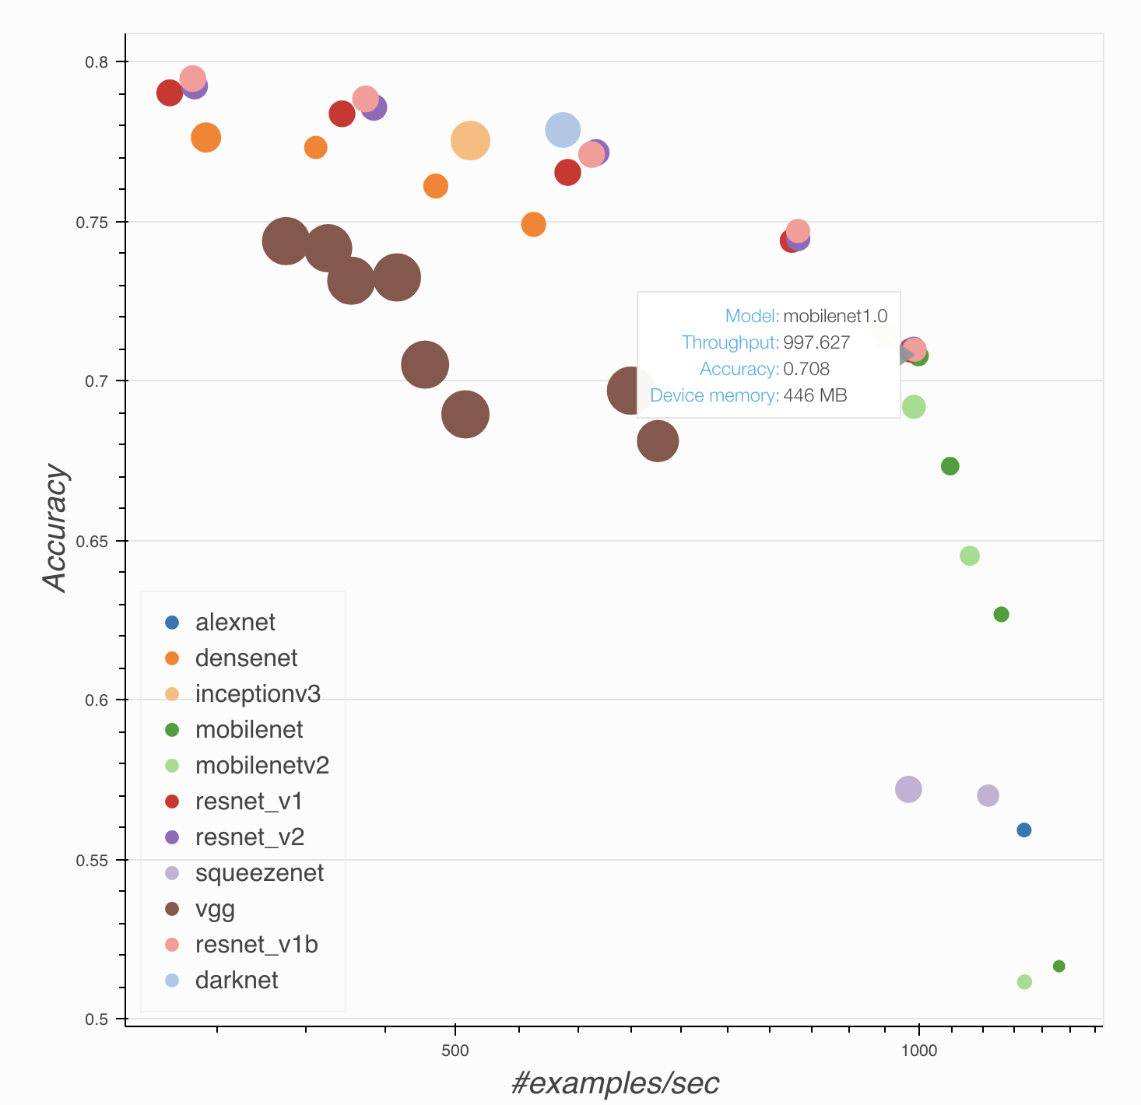
GluonCV: pre-trained models, help to choose

Slide 32
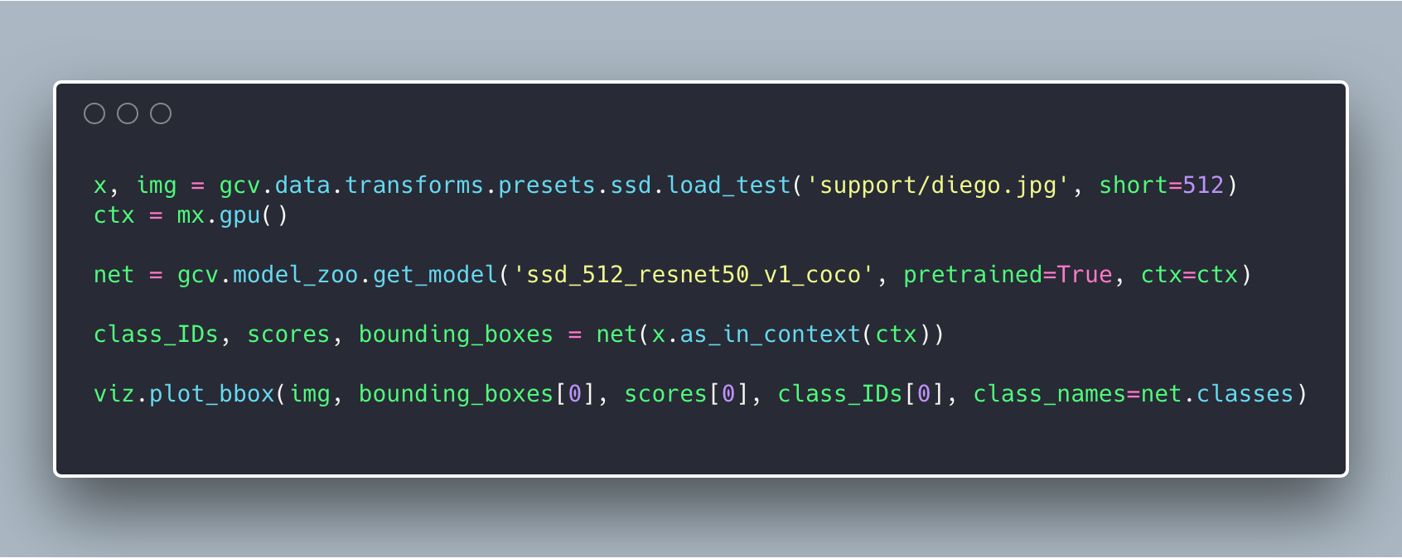
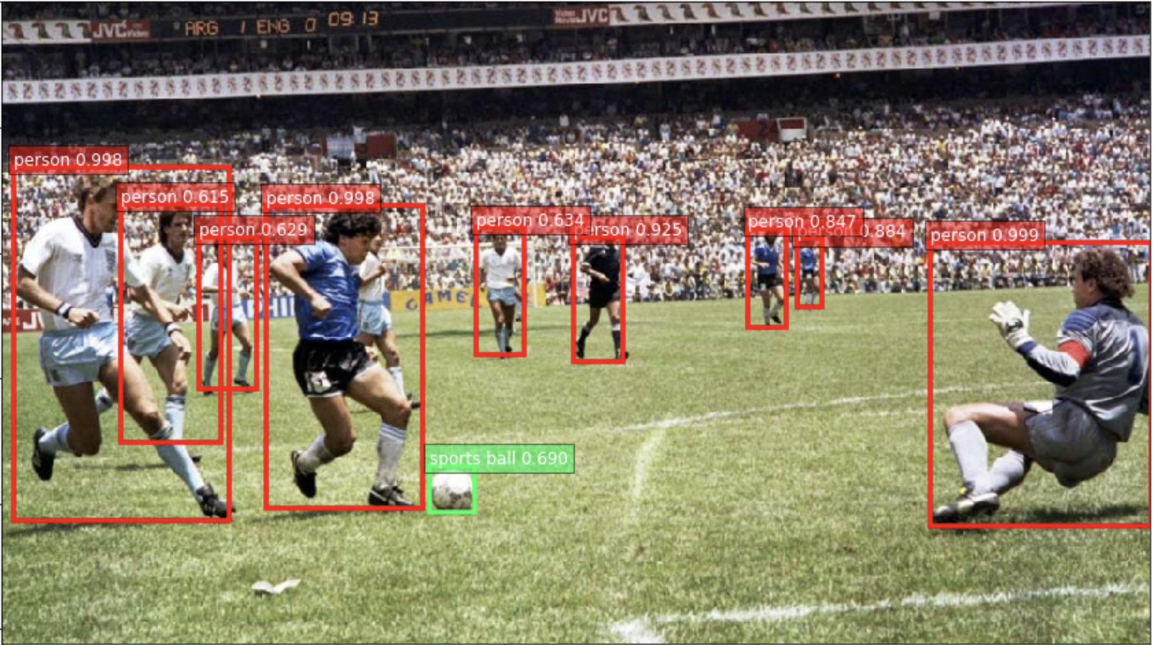
GluonCV: example code

Slide 33
Apache MXNet Ecosystem
ONNX
Framework independent format for saving models
MXNet-Model-Server
Production ready solution to serve deep learning models.
Let’s take a quick walk through ONNX Model Zoo and run inference on a model using MXNet Model Server.

Slide 34
Apache MXNet Resources
http://mxnet.incubator.apache.org/
Learn Deep Learning with Gluon - https://gluon.mxnet.io/
GitHub Repo - https://github.com/apache/incubator-mxnet
Medium: https://medium.com/apache-mxnet
Twitter: @ApacheMXNet
Wiki: https://cwiki.apache.org/confluence/display/MXNET
Subscribe to dev list – dev@mxnet.incubator.apache.org

Slide 35
Apache MXNet Evaluation
Want to learn more and start using MXNet?
Our experts can review your use cases
We will help you with an evaluation of MXNet
We can walk you through the steps to get to a production ready state
Partner with AWS!
Become a customer reference
Write a blog and receive market and peer recognition
Customer case study to promote what you’re doing in Deep Learning
Contact Marcelo Bossi to get started
Email: mbbossi@amazon.com
Cell: (650) 796-1781

Slide 36
Try it out, Star and Contribute!
http://mxnet.io
http://modelserver.io

